Slide 1

Programming and Data Structures
Debasis Samanta
Computer Science & Engineering
Indian Institute of Technology Kharagpur
Spring-2017

Slide 2
Lecture #1
Introduction to Digital Computers

Slide 3
Today’s discussion…
What is a digital computer?
The basic components of a digital computer?
How does a program run in a computer?
Why one needs program?
How one can write programs?
Your first C programs

Slide 4
History of Computer

Slide 5
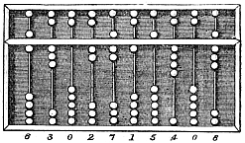
Brief history of computer…
The Chinese Suanpan (算盘)
  The number represented on this abacus is 6,302,715,408

Slide 6
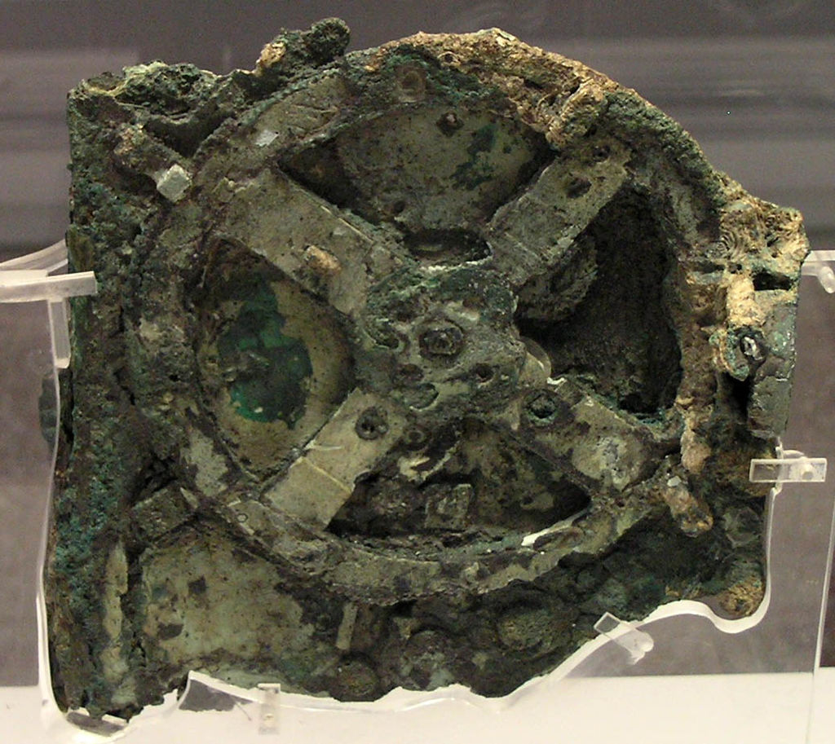
Brief history of computer…
The ancient Greek-designed Antikythera mechanism, dating between 150 and 100 BC, is the world's oldest analog computer.

Slide 7
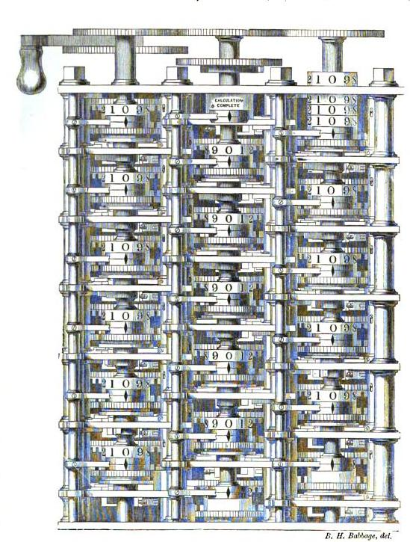
Brief history of computer…
Babbages difference engine was known as the first digital computer.

Slide 8
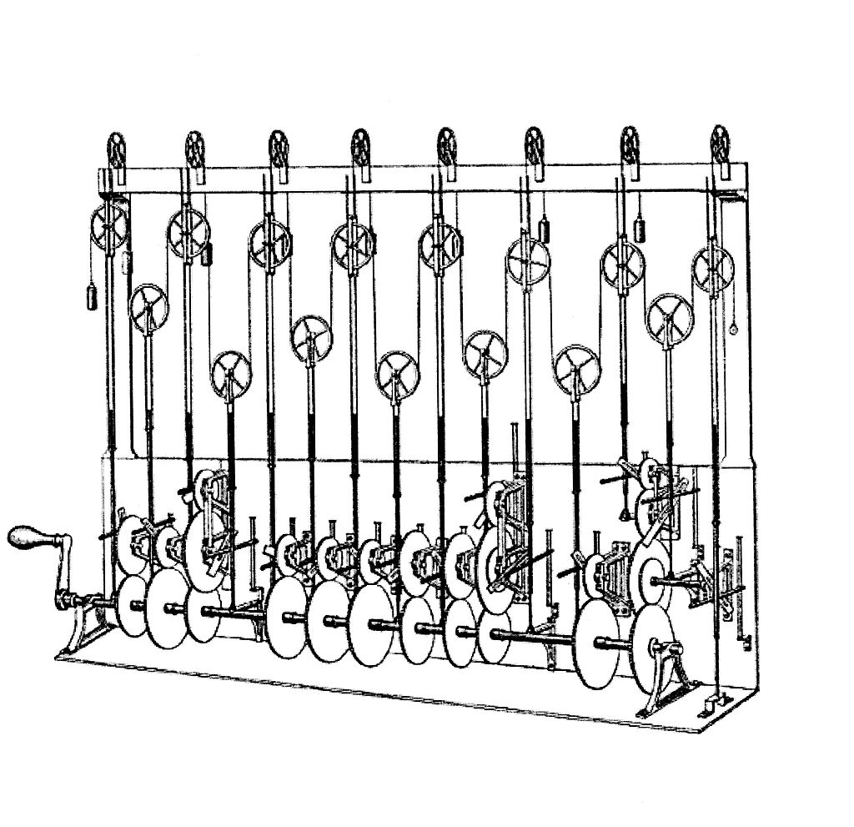
Brief history of computer…
Sir William Thomson’s tide predicting machine (1880).

Slide 9
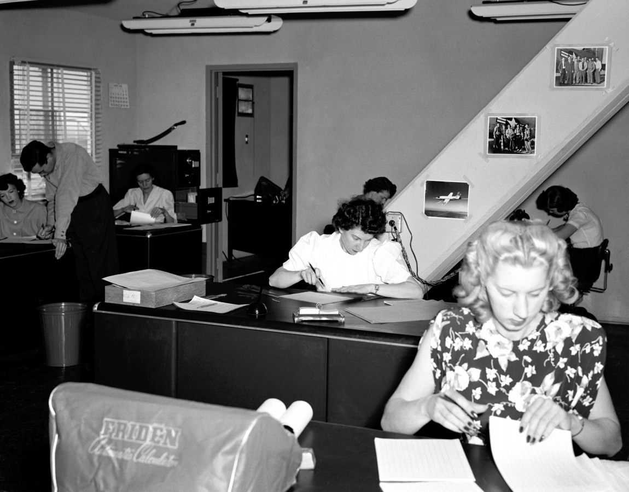
Brief history of computer…
Women as computers in NASA High Speed Flight Station "Computer Room"

Slide 10
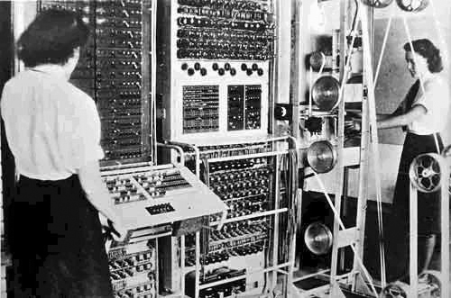
Brief history of computer…
Colossus was the first electronic digital programmable computing device, and was used to break German ciphers during World War II.

Slide 11

Brief history of computer…
ENIAC was the first Turing-complete device, and performed ballistics trajectory calculations for the United States Army.

Slide 12
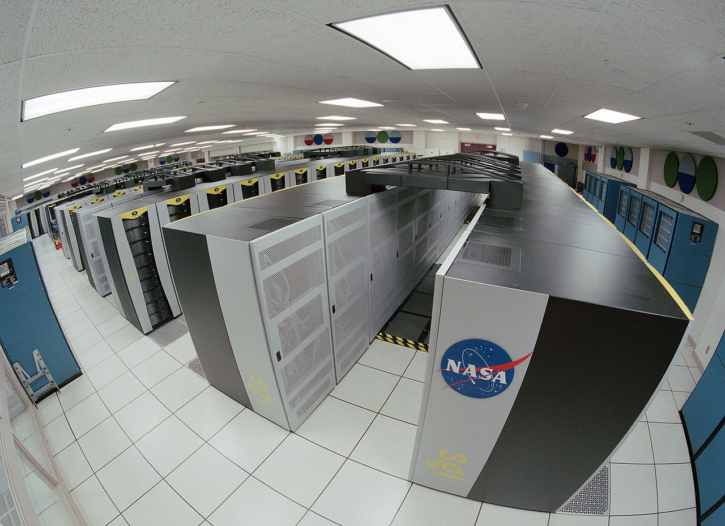
Brief history of computer…
The Columbia Supercomputer at its largest capacity at NASA's Advanced Supercomputing Facility located at NASA Ames Research Center, Moffett Field, California

Slide 13
Digital Computer

Slide 14
What is a digital computer?
A computer is an electronics machine that can perform computation.
  Number crunching machine!
Now our computer can solve many problems
  Polynomial root finding
  Matrix inversion
  Primarily testing
  Travelling salesman problem
  Weather prediction
  Web browsing
  Playing games (e.g., chess), etc.
  A computer is a device that can solve these and similar problems. A digital computer accepts, processes and outputs data in digitized forms (as opposed to analog forms).

Slide 15
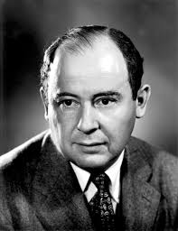
Basic components of a digital computer…
John Von Neumann (1903-1957)
  Father of “Modern Computer”
  First time he proposed the concept of “Stored-program computer”

Slide 16
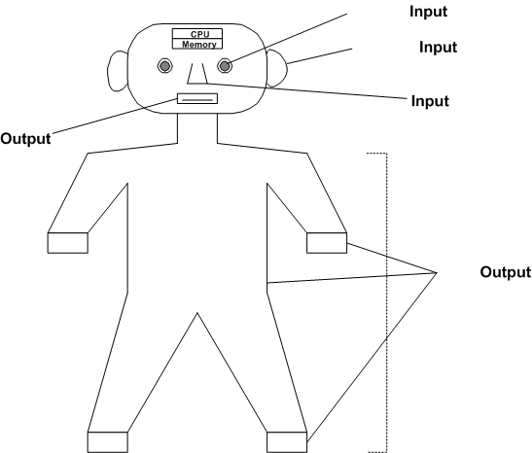
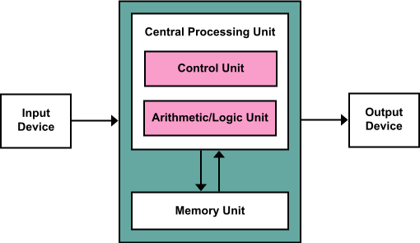
Basic components of a digital computer…
Von Neumann Computer Architecture
How a human system work?

Slide 17
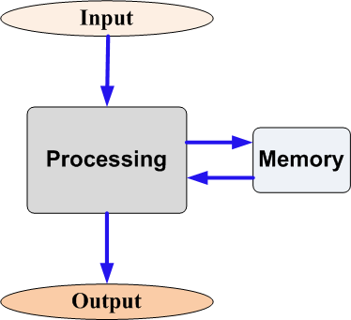
Basic components of a digital computer…
Input
  User gives a set of (zero or more) input
Processing
  The input data is processed by a well-defined and finite sequence of steps (also called program.
Output
  Some data available from the processing step are output (at least one) to the user.

Slide 18
Basic components of a digital computer…
Input devices
These are the devices using which the user provides input instances. In a programmable computer, input devices are also used to input programs.
  Example: Keyboard, mouse, scanner (camera), etc.
Processing unit
The central processing unit (CPU) is the brain of the computing device and performs the basic processing steps. A CPU typically consists of:
  An arithmetic and logical unit (ALU): This provides the basic operational units of the CPU. It is made up of units (like adders, multipliers) that perform arithmetic operations on integers and real numbers, and of units that perform logical operations (logical and bitwise AND, OR etc.).
  A control unit: This unit is responsible for controlling flow of data and instructions.
  General purpose registers: A CPU usually consists of a finite number of memory cells that work as scratch locations for storing intermediate results and values.
Output devices
These devices notify the user about the outputs of a computation.
  Example: Screen, printer, speaker, plotter, etc.

Slide 19
Fundamental in Processing

Slide 20
Fundamental in processing
Number system
  The basic things with which we compute
  Positional number systems
    Each position has a weight
    Decimal number system
      Defined with ten digits : {0, 1, 2, 3, 4, 5, 6, 7, 8, 9} with base = 10
      Example: 347 = 3×10²+4×10¹+7×10⁰
    Hexa-decimal number system
      Defined with 16 numerals : {0, 1, 2, 3, 4, 5, 6, 7, 8, 9, A, B, C, D, E, F} with base = 16
      Example: (3A7)₁₆ = 3×16²+A×16¹+7×16⁰ = (935)₁₀
    Binary number system
      Defined with two bits: {0, 1} with base = 2
      Example: (1110)₂ = 1×2³+1×2²+1×2¹+0×2⁰ = (14)₁₀

Slide 21
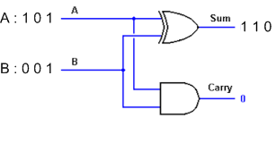
Fundamental in processing
Number system
  Non-positional number systems
    Any position has no weight
      Example: Roman number system : I, II, III, IV, etc.
  Today’s digital computer processes mainly binary number system
    This is so because, a digital computer is built out of tiny electronic switches.
    From the viewpoint of ease of manufacturing and reliability, such switches can be in one of two states, ON or OFF, which can be represented by 0 (OFF) and 1 (ON).
    Example: A + B = C

Slide 22
Fundamental in processing
Concepts of bits and bytes
  Bit : A single binary unit, that is, 0 or 1
  Nibble: A collection of 4 bits
    Example: 1001, 1100, etc.
  Byte: A collection of 8 bits
    Example: 11001001
  Word: Typically 4 or 8 bytes (depending on the architecture of computers)
    Example, an Intel Pentium P5 (i-586) processor uses 32-bits as a word
  Larger memory chunks
    Kilobyte (KB) : 1 KB = 2¹⁰ = 1024 bytes
    Megabyte (MB) : 1 MB = 2²⁰ ≈ 1 million
    Gigabyte (GB) : 1 GB = 2³⁰ ≈ 1 billion

Slide 23
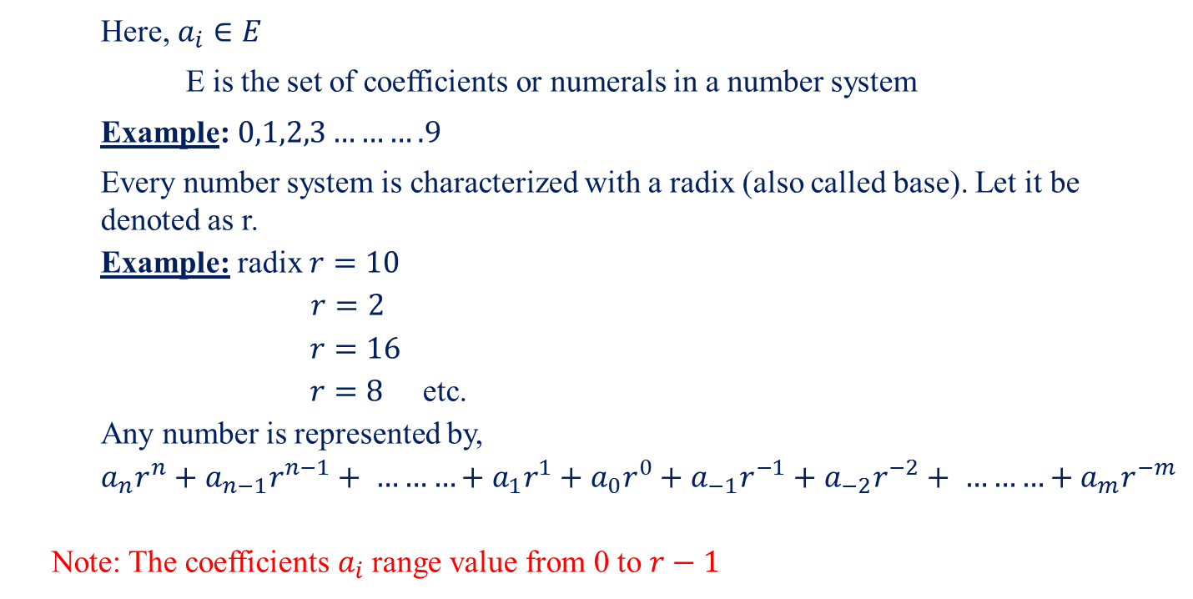


Number Representation
    whole part
fractional part
$$a_{n} a_{n+1}………a_{2} a_{1} a_{0}$$
.
$$a_{−1} a_{−2}………a_{−m}$$
    Here, $a_{i}∈E$
    E is the set of coefficients or numerals in a number system
    Example: $0,1,2,3……….9$
    Every number system is characterized with a radix (also called base). Let it be denoted as r.
    Example: radix $r=10$
    $r=2$
    $r=16$
    $r=8$ etc.
    Any number is represented by,
    $$a_{n}r^{n}+a_{n−1}r^{n−1}+ ………+a_{1}r^{1}+a_{0}r^{0}+a_{−1}r^{−1}+a_{−2}r^{−2}+ ………+a_{m}r^{−m}$$
    Note: The coefficients${ a}_{i}$ range value from 0 to $r−1$

Slide 24

Decimal Number System
    (Radix) Base:10
    $$E=\{0,1,2,3,4,5,6,7,8,9\}$$
    Example:
    $${(7392)}_{10}=7×{10}^{3}+3×{10}^{2}+9×{10}^{1}+2×{10}^{0}$$
    $${(203.147)}_{10}=2×{10}^{3}+0×{10}^{1}+3×{10}^{0}+1×\frac{1}{10}+4×\frac{1}{{10}^{2}}+7×\frac{1}{{10}^{3}}$$
    What is the decimal equivalent of
    ${(203.147)}_{5}$
    ${(B65F)}_{16}$

Slide 25

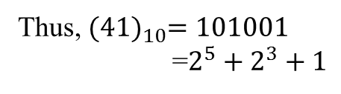
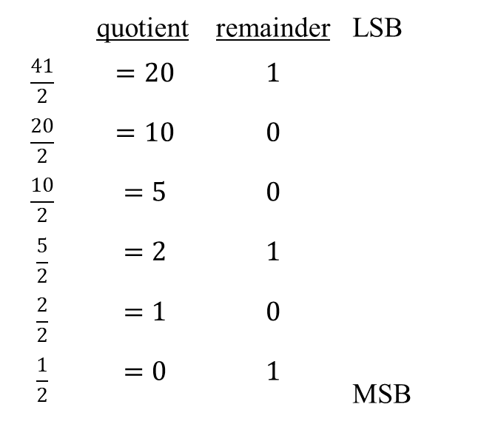
Binary Number System
    $${(1010.011)}_{2}$$
    $$≡2^{3}+0+2^{1}+0+0+\frac{1}{2^{2}}+\frac{1}{2^{3}}$$
    $$≡{(10.375)}_{10}$$
    Convert decimal ${(41)}_{10}$ to binary
 | quotient | remainder | LSB MSB
$$\frac{41}{2}$$ | $$=20$$ | $$1$$
$$\frac{20}{2}$$ | $$=10$$ | $$0$$
$$\frac{10}{2}$$ | $$=5$$ | $$0$$
$$\frac{5}{2}$$ | $$=2$$ | $$1$$
$$\frac{2}{2}$$ | $$=1$$ | $$0$$
$$\frac{1}{2}$$ | $$=0$$ | $$1$$
Thus, ${(41)}_{10}=101001$
=$2^{5}+2^{3}+1$

Slide 26


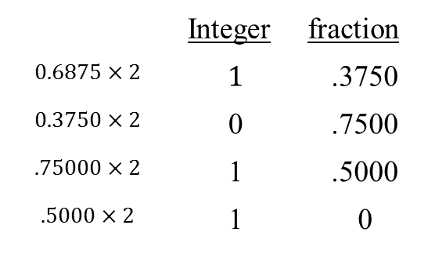
Binary Number System
    Convert decimal ${(.6875)}_{10}$ to binary
    Convert ${(41.6875) }_{10}$ to binary
 | Integer | fraction
$$0.6875×2$$ | $$1$$ | .3750
$$0.3750×2$$ | 0 | .7500
$$.75000×2$$ | 1 | .5000
$$.5000×2$$ | 1 | 0
Thus, ${(.6875)}_{10}={(0.1011)}_{2}$

Slide 27



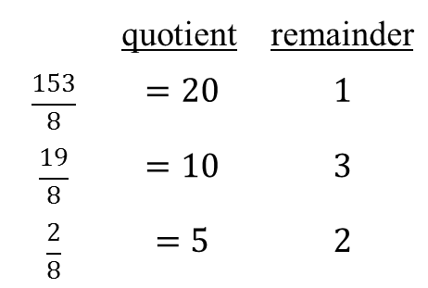
Octal Number System
    Convert decimal ${(153)}_{10}$ to octal
    Convert ${(0.513)}_{10} to octal$ upto seven significant figures.
 | quotient | remainder
$$\frac{153}{8}$$ | $$=20$$ | $$1$$
$$\frac{19}{8}$$ | $$=10$$ | $$3$$
$$\frac{2}{8}$$ | $$=5$$ | $$2$$
$${(231)}_{8}$$
$${2×8}^{2}+3×8^{1}+1×8^{0}$$

Slide 28

Complement
${(5492)}_{10}$in its compliment form is ${(5618)}_{10}$
${10}^{′}s$ complement
$$\left[\left(r^{n}−1\right)−N\right]+1$$
This is also called $9^{′}s$ complement and is denoted as $r^{n}−N$
${10}^{′}s$ complement of 012398 is 987602
$1^{′}s$ complement of 1011000 is 0100111
$2^{′}s$ complement of 1101100 is 0010100
9999 – 5492 = 5618
0010011
+1
= 0010100
The $1^{′}s$ complement of ${\text{(1101100)}}_{2}$is ${\text{(0010011)}}_{2}$

Slide 29
Arithmetic's in binary number system
Addition | Sum | Carry
0+0 | 0 | 0
0+1 | 1 | 0
1+0 | 1 | 0
1+1 | 0 | 1
1+1+1 | 1 | 1
Example: 101101
+ 010111
1000100
C=A+B

Slide 30
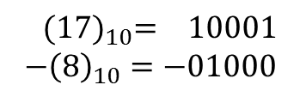
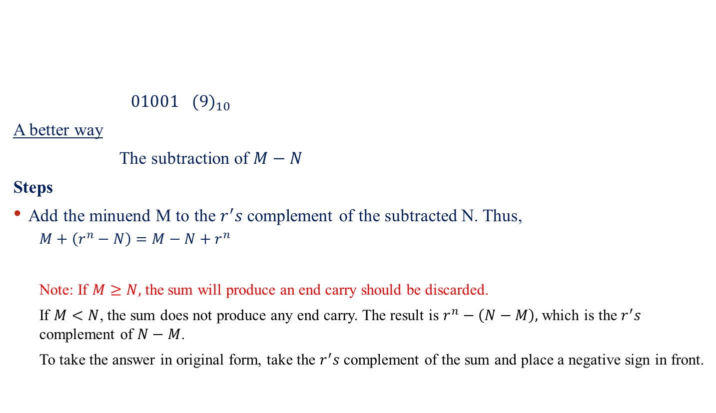
Arithmetic's in binary number system
$01001 {(9)}_{10}$
A better way
The subtraction of $M−N$
Steps
Add the minuend M to the $r^{′}s$ complement of the subtracted N. Thus,
  $$M+\left(r^{n}−N\right)=M−N+r^{n}$$
  Note: If $M≥N,$ the sum will produce an end carry should be discarded.
  If $M<N$, the sum does not produce any end carry. The result is $r^{n}−\left(N−M\right),$which is the $r^{′}s$ complement of $N−M$.
  To take the answer in original form, take the $r^{′}s$ complement of the sum and place a negative sign in front.
${(17)}_{10}= 10001$
$$−{\left(8\right)}_{10}=−01000$$

Slide 31

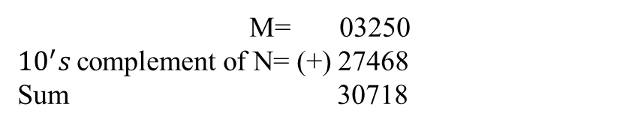
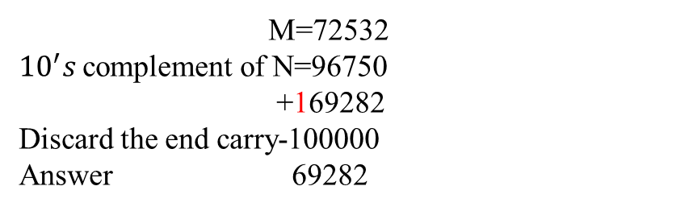
Arithmetic's in binary number system
Example: Using ${10}^{′}s$ complement, subtract $72532−3250$
Example: Using ${10}^{′}s$ complement, subtract $3250−72532$
Answer: $−$(${10}^{′}s$ complement of 30718)
=$−69282$
M=72532
${10}^{′}s$complement of N=96750
+169282
Discard the end carry-100000
Answer 69282
M= 03250
${10}^{′}s$complement of N= (+) 27468
Sum 30718
There is no end carry

Slide 32

Arithmetic's in binary number system
$$X=1010100$$
$$Y=1000011$$
Obtain (a) $X−Y$
(b) $Y−X$
X=1010100
$2^{′}s$ complement of Y=0111101
Sum (+) 10010001
Discard end carry 10000000
Answer 0010001
Y=1000011
$2^{′}s$ complement of X=0111101
Sum (+) 1101111
Answer $−2^{′}s$ complement of 1101111
=$−(00100001)$
There is no end carry

Slide 33


Signed binary number
The MSB represents the sign of the number
$$0→positive$$
$$1→negative$$
Example
 | Unsigned | Signed
$$0 0 0$$ | 0 | +0
$$0 0 1$$ | 1 | +1
$$0 1 0$$ | 2 | +2
$$0 1 1$$ | 3 | +3
$$1 0 0$$ | 4 | -0
$$1 0 1$$ | 5 | -1
$$1 1 0$$ | 6 | -2
$$1 1 1$$ | 7 | -3

Slide 34
Computer Architecture

Slide 35
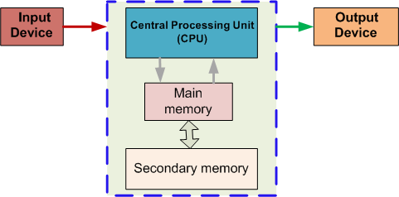
Basic components of a digital computer…
Memory
This unit stores the program to be executed.
  Register
    Memory resides within the processing unit
  Primary memory (also called main memory)
    This is a high-speed memory that stays close to the CPU.
    Programs are first loaded in the main memory and then executed.
    Usually main memory is volatile, i.e., its contents are lost after power-down.
  Secondary memory
    This is relatively inexpensive, bigger and low-speed memory.
    It is normally meant for off-line storage, i.e., storage of programs and data for future processing.
    One requires secondary storage to be permanent, i.e., its contents should last even after shut-down.
    Examples of secondary storage include floppy disks, hard disks and CDROM disks.
Buses
A bus is a set of wires that connect the above components. Buses are responsible for movement of data from input devices, to output devices and from/to CPU and memory.

Slide 36
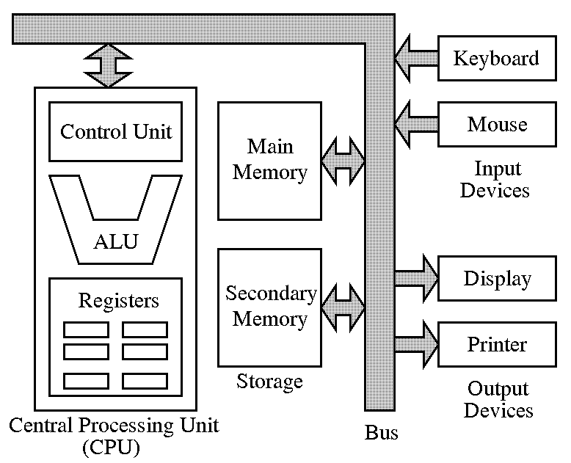
Basic components of a digital computer…
John Von Neumann architecture

Slide 37
Typical configuration of a computer
Feature | Specification
CPU | Intel(R) Core(TM) i5-4570 CPU, 3.2 GHz
Main memory | 4 GB
Hard disk | 1 TB
Floppy disk | Not required
CDROM | DVD RW combo-drive
Input device | Keyboard, mouse, joystick
Output device | TFT Monitor
Ports | 4 USB, Infrared, Firewire

Slide 38
How a program runs in computer?

Slide 39
Why we need a program?
?
High speed computation
  The electronic speed possessed by computers for processing data is really fabulous.
Many problems and hence many programs. The same computer can be used to solve many problems.
  This is why computer is “general purpose” digital device!
Same problem but have many programs.
    A custom program can better solves your problem than a readymade program.

Slide 40
How can one program?
A program is essentially to specify the exact way in which the fetch-decode-execute cycle is to be carried out so that your problem is solved. This needs a language to specify.
Machine language
  Machine can understand only two voltage levels{ 0 (low voltage) and 1 (high voltage)}
    Instruction should be given in such a way, so that machine can understand
      Example: 001100110001111010
    The machine language is so low-level that writing a program in this language is a very formidable task. One ends up with unmanageably huge codes that are very error-prone and extremely difficult to debug and update.

Slide 41
How can one program?
Assembly language
  The CPU of a computer supports a primitive set of instructions (typically, data movement, arithmetic, logical and jump instructions).
  Writing a program using these instructions (called assembly instructions)
  The assembly language varies from machines to machines.
  The assembly codes suitable for one machine need not be understood by another machine. Moreover, different machines support different types of assembly instructions and there is no direct translation of instructions of one machine to those of another.
  For example, the ALU of Computer A may support integer multiplication, whereas that of Computer B does not. You have to translate each single multiplication instruction for Computer A to your own routine (say, involving additions and shifts) for doing multiplication in Computer B.

Slide 42
How can one program?
A view of Assembly level program
MOV A,X ; A = X
ADD A,Y ; A = A + Y
ADD A,Z ; A = A + Z
DIV A,3 ; A = A / 3
MOV RES,A ; RES = A
This program finds the average of three numbers.

Slide 43
How can one program?
High-level language
  A high-level language helps you make your communication with computers more abstract and simpler and also widely machine-independent.
  You then require computer programs that convert your high-level description to the assembly-level descriptions of individual machines, one program for each kind of CPU. Such a translator is called a compiler.
  Therefore, your problem solving with computers involves the following three steps:
    Write the program in high-level language, For example, Z = (A + B + C)/3
    Compile your program to get machine level program.
    Run the machine executable file.

Slide 44
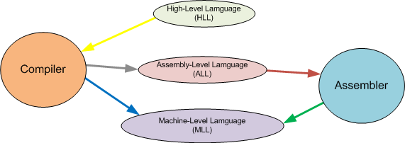
How can one program?
The relationships among HLL, ALL and MLL
How an Interpreter come into this picture?

Slide 45
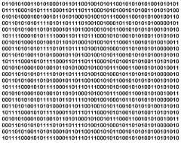
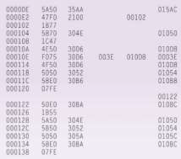
How can one program?
Views of machine level programs
In binary representation
In hexa-decimal representation

Slide 46
How a program runs in computer?

Slide 47
How a program runs in computer?
The inputs, the intermediate values and the instructions defining the processing stage reside in the (main) memory. In order to separate data from instructions the memory is divided into two parts:
  Data area
    The data area stores the variables needed for the processing stage.
    The values stored in the data area can be read, written and modified by the CPU. The data area is often divided into two parts: a stack part and a heap part.
      The stack part typically holds all statically allocated memory (global and local variables), whereas the heap part is used to allocate dynamic memory to programs during run-time.
  Instruction area
    The instruction area stores a sequence of instructions that define the steps of the program.
    Under the control of a clock, the computer carries out a fetch-decode-execute cycle in which instructions are fetched one-by-one from the instruction area to the CPU, decoded in the control unit and executed in the ALU.
      The CPU understands only a specific set of instructions. The instructions stored in memory must conform to this specification.

Slide 48
How a program runs in computer?
The fetch-decode-execute cycle in computer
  For starting the execution of a program, a sequence of machine instructions is copied to the instruction area of the memory. Also some global variables and input parameters are copied to the data area of the memory.
  A particular control register, called the program counter (PC), is loaded with the address of the first instruction of the program.
  The CPU fetches the instruction from that location in the memory that is currently stored in the PC register.
  The instruction is decoded in the control unit of the CPU.
  The instruction may require one or more operands. An operand may be either a data or a memory address. A data may be either a constant (also called an immediate operand) or a value stored in the data area of the memory or a value stored in a register. Similarly, an address may be either immediate or a resident of the main memory or available in a register.
  An immediate operand is available from the instruction itself. The content of a register is also available at the time of the execution of the instruction. Finally, a variable value is fetched from the data part of the main memory.
  If the instruction is a data movement operation, the corresponding movement is performed. For example, a "load" instruction copies the data fetched from memory to a register, whereas a "save" instruction sends a value from a register to the data area of the memory.
  If the instruction is an arithmetic or logical instruction, it is executed in the ALU after all the operands are available in the CPU (in its registers). The output from the ALU is stored back in a register.
  If the instruction is a jump instruction, the instruction must contain a memory address to jump to. The program counter (PC) is loaded with this address. A jump may be conditional, i.e., the PC is loaded with the new address if and only if some condition(s) is/are true.
  If the instruction is not a jump instruction, the address stored in the PC is incremented by one.
  If the end of the program is not reached, the CPU goes to Step 3 and continues its fetch-decode-execute cycle.

Slide 49
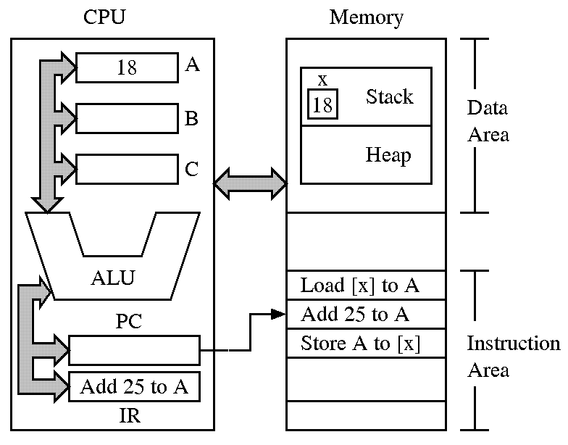
How a program runs in computer?
Execution of a program

Slide 50
How can one program?
Program writing in a high-level language
  You should use a text editor to key in your program. In the laboratory we instruct you to use the emacs editor. You should also save your program in a (named) file.
  We are going to teach you the high-level language known as C.
Compile your program
  You need a compiler to do that. In the lab you should use the C compiler cc (a.k.a. gcc).
  cc myprog.c
  If your program compiles successfully, a file named a.out (an abbreviation of "assembler output") is created. This file stores the machine instructions that can be understood by the particular computer where you invoked the compiler.
  If compilation fails, you should check your source code. The reason of the failure is that you made one or more mistakes in specifying your idea. Compilers are very stubborn about the syntax of your code. Even a single mistake may let the compiler churn out many angry messages.
Run the machine executable file
  This is done by typing
  ./a.out
  (and then hitting the return/enter button) at the command prompt.

Slide 51
Introduction to C Programming

Slide 52
Introduction to C
C is a general-purpose, structured programming language.
  Resembles other high-level structured programming languages, such as Pascal and Fortran-77.
  Also contains additional features which allow it to be used at a lower level.
C can be used for applications programming as well as for systems programming.
There are only 32 keywords and its strength lies in its built-in functions.
C is highly portable, since it relegated much computer dependent features to its library functions.

Slide 53
Introduction to C
Originally developed in the 1970’s by Dennis Ritchie at AT&T Bell Laboratories.
  Outgrowth of two earlier languages BCPL and B.
Popularity became widespread by the mid 1980’s, with the availability of compilers for various platforms.
Standardization has been carried out to make the various C implementations compatible.
  American National Standards Institute (ANSI), For example, ANSI-C, Turbo-C, etc.

Slide 54
Your first C-programs
  This program takes no input, but outputs the string "Hello, world!" in a line.

Slide 55
Your first C-programs
  This program accepts an integer as input and outputs the same integer. This program is called Short-circuit program!

Slide 56
Your first C-programs
  This program takes an integer n as input and outputs its square n².

Slide 57
Your first C-programs
  This program takes an integer n as input and is intended to compute its reciprocal 1/n. This program is called Reciprocal Printer.
Really this program works?

Slide 58
Your first C-programs
  A corrected version of the Reciprocal Printer is as follows:
Do you think that still it works??

Slide 59

Any question?
  You may post your question(s) at the “Discussion Forum” maintained in the course Web page.

Slide 60
Problems to ponder…
What was the use “Suanpan”, ancient Greek “Analog Computers” and “Babbage’s Difference Engine”?
What is the full form of ENIAC?
What is the main difference between a “computer” and “calculator”?
What is cache memory? What is a virtual memory? What are there uses?
What is the difference between a “compiler” and an “interpreter”?. What are the merits and demerits in them?
What was a punch card (once it was extensively used in IBM 360/20 system)?
Why a keyboard is called the standard input device and VDU is called the standard display device?
A CPU with 32-bits: What it does mean? Does a CPU with 64-bits better than the 32-bits one?
Who carries user input from user to CPU and output from CPU to user?
How 250.67 can be converted into a value in binary number system?

Slide 61
Problems to ponder…
If you successfully compile the C-program in Slide #36, it will produce a file called “a.out”. If you open the “a.out” file with an editor say emacs, it will display the content in it. Can you extract anything from it? What is your conclusion?
Why the name “C” is in C-programming language?
What is the other higher order for memory chunks beyond GB?
Find a method to convert hexa-decimal number into binary and vice-versa

Slide 62
Problems for practice…
You can check the Moodle course management system for a set of problems for your own practice.
  Login to the Moodle system at cse.iitkgp.ac.in
  Select “PDS Spring-2017 (Theory) in the link “My Courses”
  Go to Topic 1: Practice Sheet #01 : Introduction to Computer
Solutions to the problems in Practice Sheet #01 will be uploaded in due time.

Slide 63
  If you try to solve problems yourself, then you will learn many things automatically.
  Spend few minutes and then enjoy the study.

